Slide 1
Task Management
Created By:
Razan Hayajneh
Heba Al-jedayah
Supervided By:
Dr. Ahmad Alsalem

Slide 2
TABLE OF CONTENTS
01
04
Overview
Admin App Demo
02
05
Methodology
Task Manager App Demo
03
06
RESTfull API
Challenages

Slide 3
Overview

Slide 4
02
Methodology

Slide 5
Task Management
GoDaddy(CPanel Hosting)
http://taskmanagement.schooldemos.com/
For Database: MyPHPAdmin
Backend: using Laravel framework (PHP)
For Frontend:
Using Nodejs for admin application
Using Flutter for team member application

Slide 6
03
RESTfull API

Slide 7
RESTful APIs work
The user sends a request to the server.
The server authenticates the user and confirms that has the right to make that request
The server receives the request
The server returns a response to the user with the requested information if the request is successful

Slide 8
RESTful API request
Method:
GET|POST|PUT|DELETE
HTTP headers:
Data: for POST|PUT
Parameters: for URL
Authentication Methods:
Basic authentication: login/register
Bearer authentication: any other API such as get projects

Slide 9
RESTful API server response
Status line:
200: Generic success response
404: Resource not found
500: Server Error
Message body:
JSON formats: using in flutter project

Slide 10
WEB APIs
Method | URI | Name | Action
GET|HEAD | login | login | Laravel\Fortify\Http\Controllers\AuthenticatedSessionController@create
POST | login | login | Laravel\Fortify\Http\Controllers\AuthenticatedSessionController@store
GET|HEAD | forgot-password | password.request | Laravel\Fortify\Http\Controllers\PasswordResetLinkController@create
POST | forgot-password | password.email | Laravel\Fortify\Http\Controllers\PasswordResetLinkController@store
GET|HEAD | reset-password/{token} | password.reset | Laravel\Fortify\Http\Controllers\NewPasswordController@create
PUT | user/password | user-password.update | Laravel\Fortify\Http\Controllers\PasswordController@update
POST | logout | logout | Laravel\Fortify\Http\Controllers\AuthenticatedSessionController@destroy
GET|HEAD | dashboard | profile.show | App\Http\Controllers\Admin\DashboardController@index
GET|HEAD | profile |  | Closure
GET|HEAD | admins | admins.index | App\Http\Controllers\Admin\AdminController@index
POST | admins | admins.store | App\Http\Controllers\Admin\AdminController@store
GET|HEAD | admins/create | admins.create | App\Http\Controllers\Admin\AdminController@create
GET|HEAD | admins/{ admin }/ edit | admins.edit | App\Http\Controllers\Admin\AdminController@edit
PUT|PATCH | admins/{ admin } | admins.update | App\Http\Controllers\Admin\AdminController@update
DELETE | admins/{ admin } | admins.destroy | App\Http\Controllers\Admin\AdminController@destroy

Slide 11
WEB APIs
Method | URI | Name | Action
GET|HEAD | teamMembers | teamMembers.index | App\Http\Controllers\Admin\TeamMemberController@index
GET|HEAD | teamMembers/{teamMember}/ edit | teamMembers.edit | App\Http\Controllers\Admin\TeamMemberController@edit
PUT|PATCH | teamMembers/{ teamMember } | teamMembers.update | App\Http\Controllers\Admin\TeamMemberController@update
DELETE | teamMembers/{ teamMember } | teamMembers.destroy | App\Http\Controllers\Admin\TeamMemberController@destroy
GET|HEAD | categories | categories.index | App\Http\Controllers\Admin\TaskCategoryController@index
POST | categories | categories.store | App\Http\Controllers\Admin\TaskCategoryController@store
GET|HEAD | categories/create | categories.create | App\Http\Controllers\Admin\TaskCategoryController@create
GET|HEAD | categories/{category}/ edit | categories.edit | App\Http\Controllers\Admin\TaskCategoryController@edit
PUT|PATCH | categories/{category} | categories.update | App\Http\Controllers\Admin\TaskCategoryController@update
DELETE | categories/{category} | categories.destroy | App\Http\Controllers\Admin\TaskCategoryController@destroy

Slide 12
APPLICATION APIs
Method | URI | Action
POST | api/v1/register | App\Http\Controllers\API\AuthAPIController@register
POST | api/v1/login | App\Http\Controllers\API\AuthAPIController@login
POST | api/v1/ logout | App\Http\Controllers\API\AuthAPIController@logout
GET|HEAD | api/v1/get-profile-info | App\Http\Controllers\API\ProfileAPIController@show
POST | api/v1/ update-profile-info | App\Http\Controllers\API\ProfileAPIController@update
POST | api/v1/update-profile-image | App\Http\Controllers\API\ProfileAPIController@updateImage
GET|HEAD | api/v1/projects | App\Http\Controllers\API\ProjectAPIController@index
POST | api/v1/projects | App\Http\Controllers\API\ProjectAPIController@store
GET|HEAD | api/v1/projects/{project} | App\Http\Controllers\API\ProjectAPIController@show
PUT|PATCH | api/v1/projects/{project} | App\Http\Controllers\API\ProjectAPIController@update
DELETE | api/v1/projects | App\Http\Controllers\API\ProjectAPIController@destroy
GET|HEAD | api/v1/project-members | App\Http\Controllers\API\ ProjectMemberAPIController@index
POST | api/v1/project-members | App\Http\Controllers\API\ProjectMemberAPIController@store
DELETE | api/v1/project-members/{project_member} | App\Http\Controllers\API\ProjectMemberAPIController@destroy
GET|HEAD | api/v1/ task-categories | App\Http\Controllers\API\ TaskCategoryAPIController@index
GET|HEAD | api/v1/tasks?project_id={id} | App\Http\Controllers\API\ TaskAPIController@index
POST | api/v1/ tasks?project_id={id} | App\Http\Controllers\API\ TaskAPIController @store
GET|HEAD | api/v1/ tasks/{task} | App\Http\Controllers\API\ TaskAPIController @show
PUT|PATCH | api/v1/ tasks/{ task} | App\Http\Controllers\API\ TaskAPIController @update
DELETE | api/v1/ tasks/{ task} | App\Http\Controllers\API\ TaskAPIController@destroy

Slide 13
APPLICATION APIs
Method | URI | Action
GET|HEAD | api/v1/my-tasks | App\Http\Controllers\API\MyTasksAPIController@index
GET|HEAD | api/v1/task-status/{id} | App\Http\Controllers\API\TaskAPIController@updateStatus
GET|HEAD | api/v1/ task-members | App\Http\Controllers\API\ TaskMemberAPIController@index
POST | api/v1/ task-members | App\Http\Controllers\API\ TaskMemberAPIController@store
DELETE | api/v1/ task-members/{ task_member} | App\Http\Controllers\API\ TaskMemberAPIController@destroy
GET|HEAD | api/v1/getCountOfFinishedTaskInProject | App\Http\Controllers\API\TaskCountAPIController@getCountOfFinishedTaskInProject
GET|HEAD | api/v1/getCountOfTaskInProject | App\Http\Controllers\API\TaskCountAPIController@getCountOfTaskInProject
GET|HEAD | api/v1/timelines?task_id={id} | App\Http\Controllers\API\TimelineAPIController@index
GET|HEAD | api/v1/ reports?task_id={id} | App\Http\Controllers\API\ ReportAPIController@index
POST | api/v1/ reports?task_id={id} | App\Http\Controllers\API\ ReportAPIController @store
GET|HEAD | api/v1/ reports/{report} | App\Http\Controllers\API\ ReportAPIController @show
PUT|PATCH | api/v1/ reports/{report} | App\Http\Controllers\API\ ReportAPIController @update
DELETE | api/v1/ reports/{report} | App\Http\Controllers\API\ ReportAPIController@destroy
GET|HEAD | api/v1/notifications | App\Http\Controllers\API\NotificationAPIController@index
POST | api/v1/notifications | App\Http\Controllers\API\NotificationAPIController@store

Slide 14
JSON

Slide 15
04
Admin App Demo

Slide 16
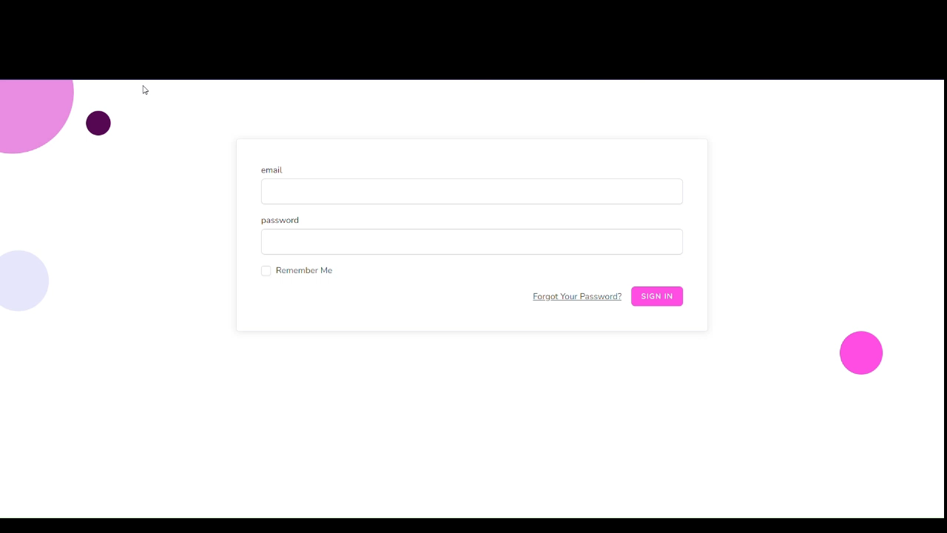

Slide 17
05
Task Manager App Demo

Slide 18
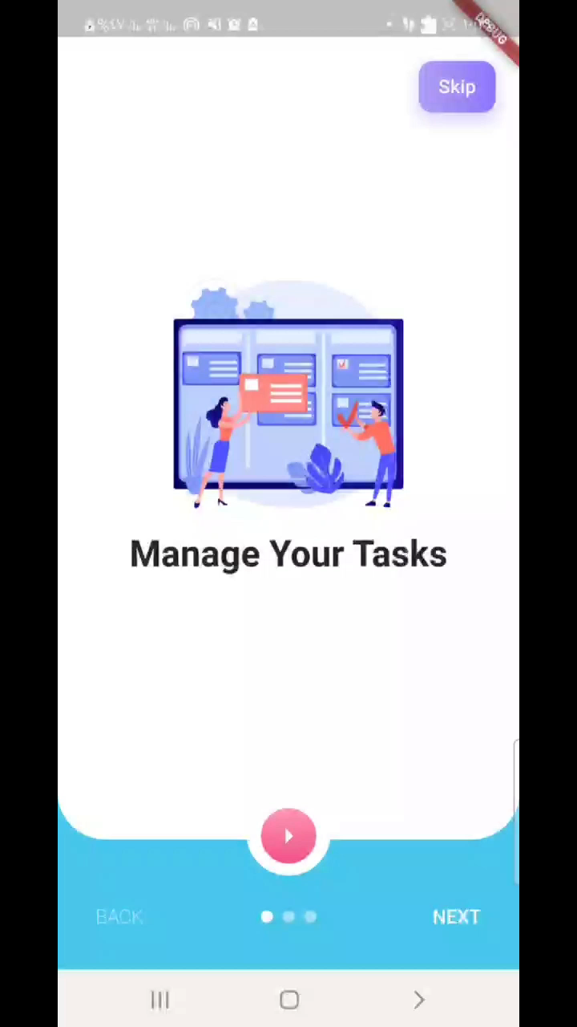

Slide 19
06
Challenges

Slide 20
Challenges in Backend
Find online server support Laravel to upload backend
Version of project

Slide 21
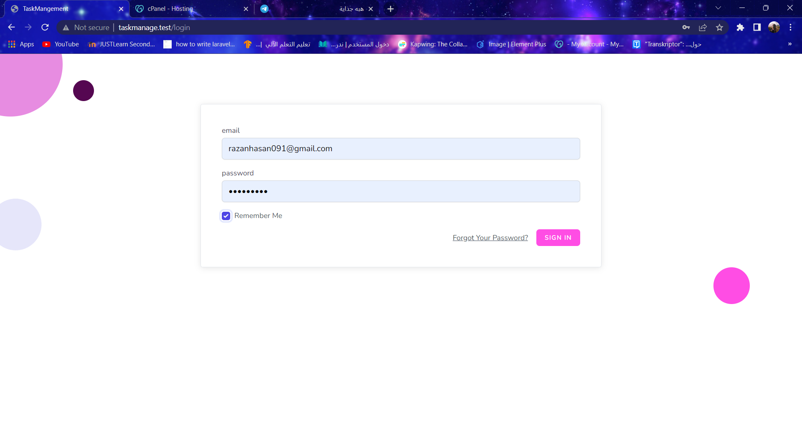

Slide 22
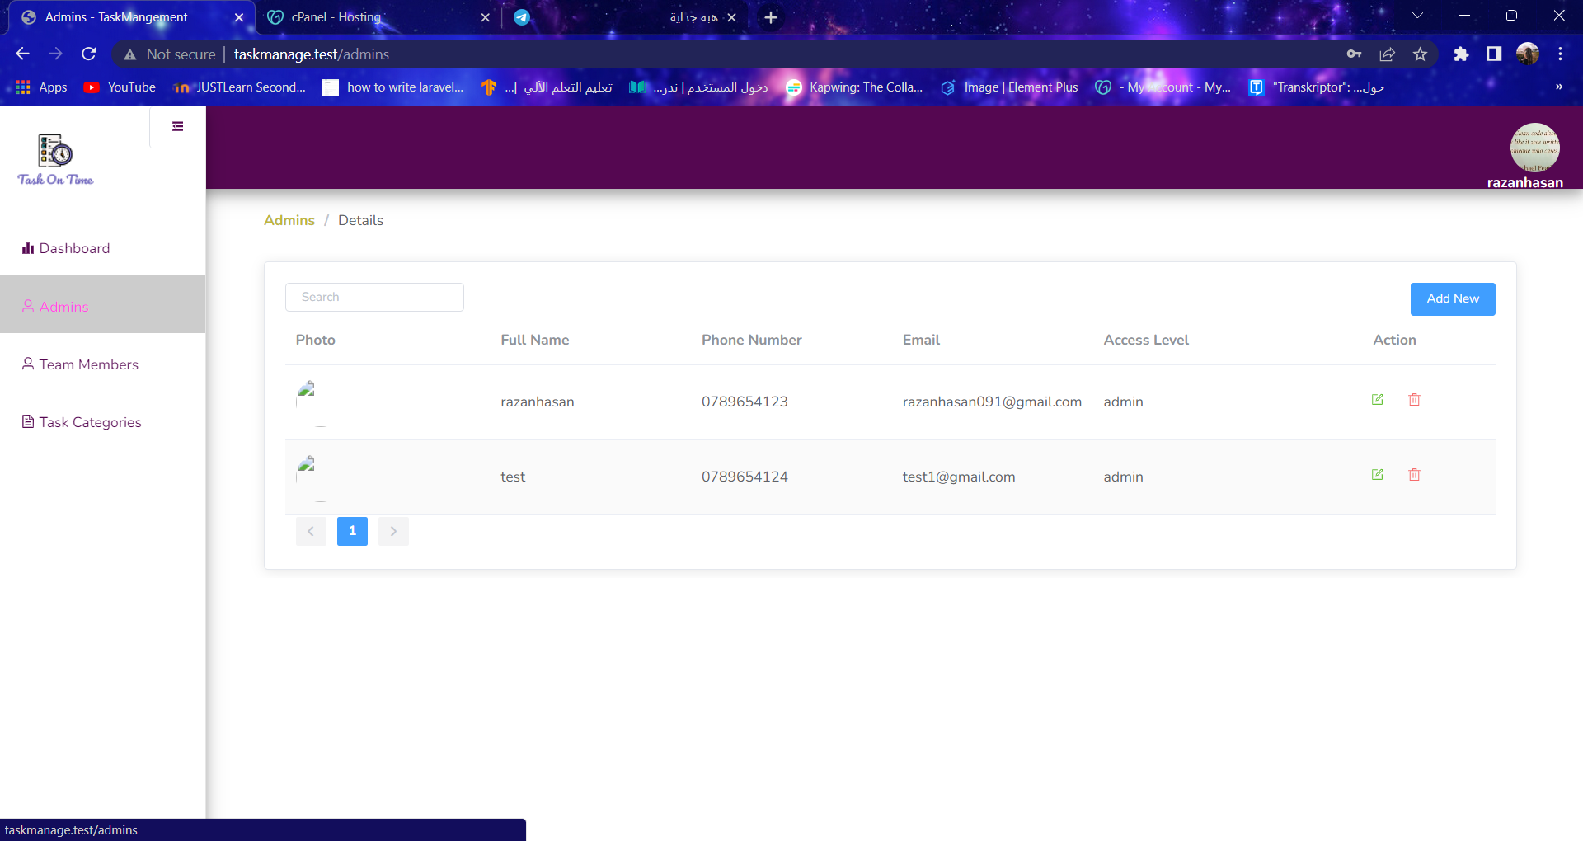

Slide 23
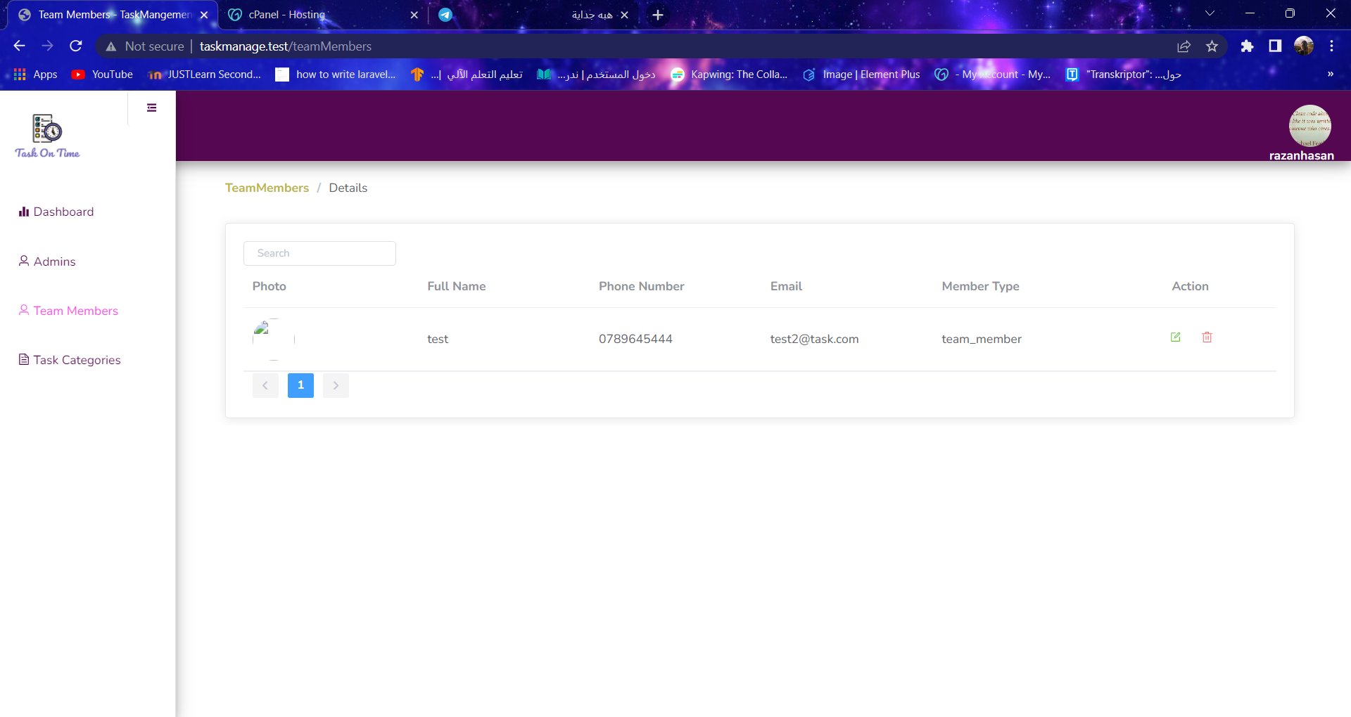

Slide 24
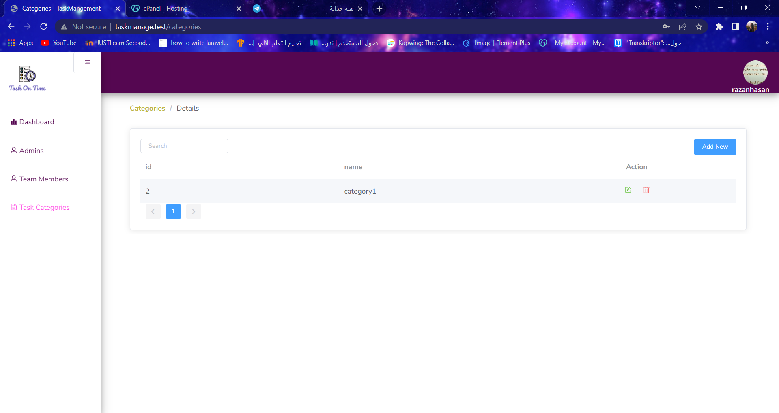

Slide 25
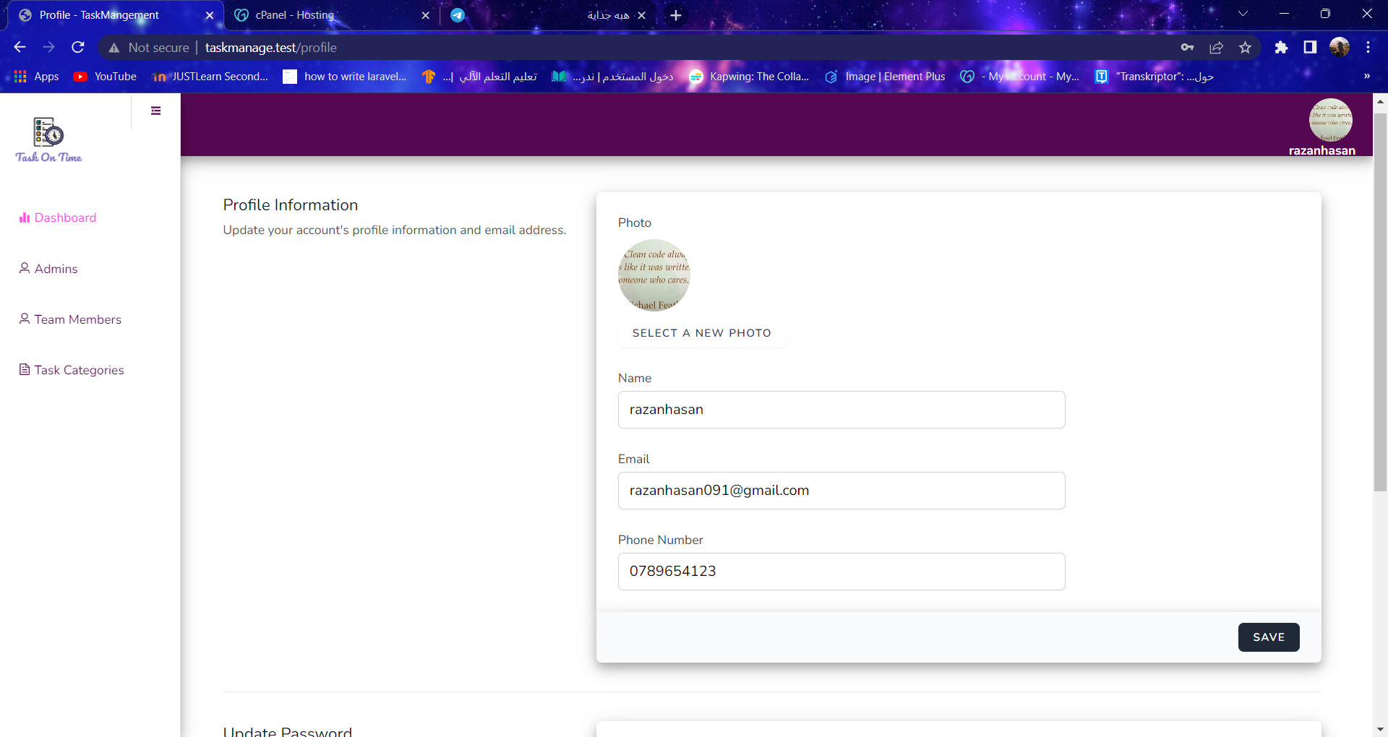

Slide 26
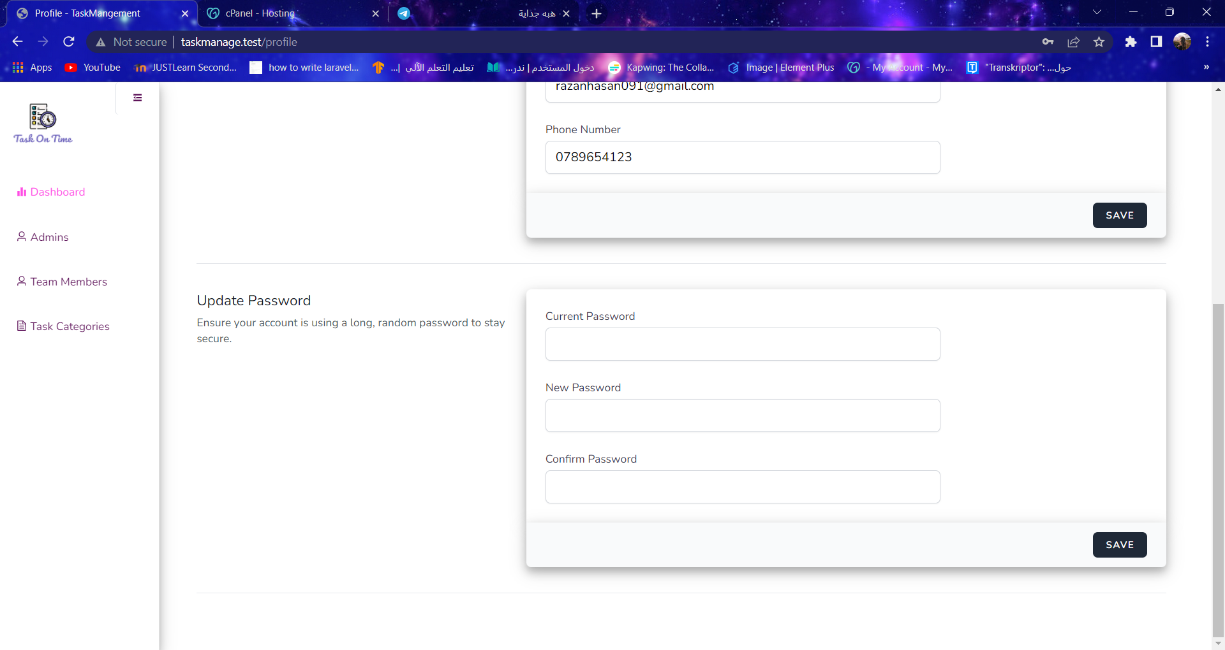

Slide 27
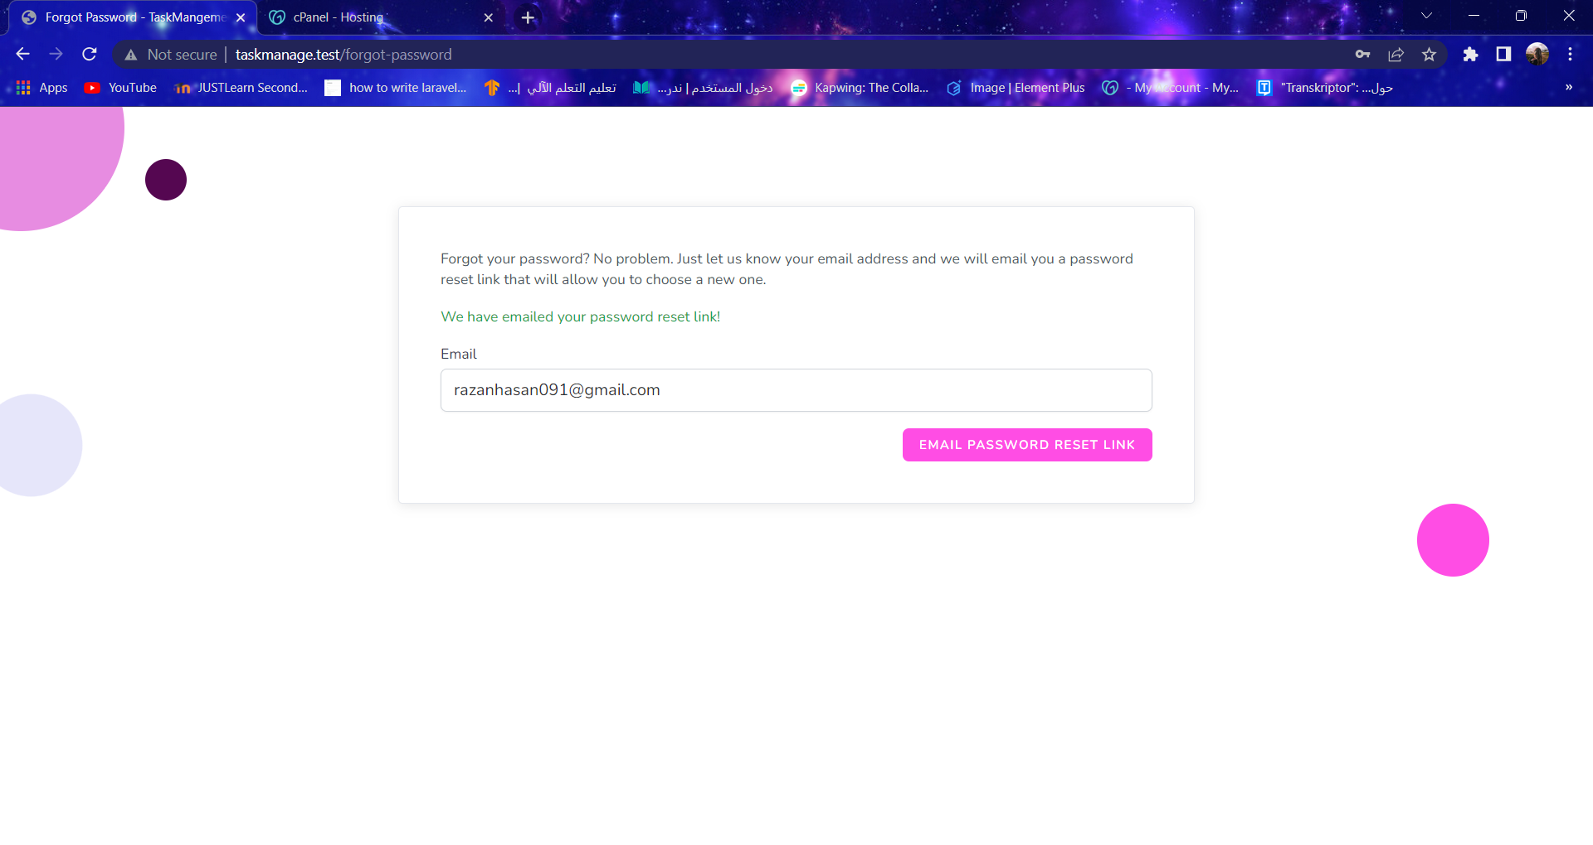

Slide 28
